Slide 1
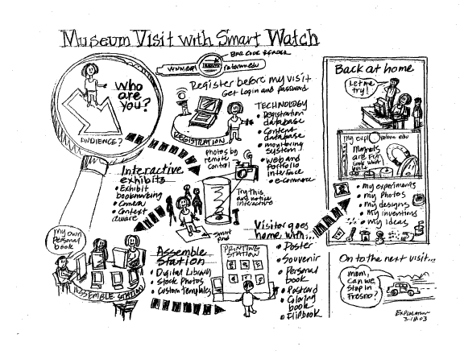
Sketching CSCI 5839– Fall 2014
Notes:
http://what-the-fail.com/computer-user-fail/

Slide 2
Today
Summaries of observation assignment (30 minutes)
Summary of input and interaction (20 minutes)
Sketching (25 minutes)

Slide 3
Assignments etc.
Due Thursday: Team Project 1
Next Thursday: peer feedback on P1
Updated readings through end of semester
Any questions?
Notes:
Open ended is part of the class, graduate class. So if you want feedback don’t hesitate to ask me or TAs

Slide 4
A3 summaries
https://drive.google.com/a/colorado.edu/folderview?id=0B-vRV62_RpG2YUxUZ29FRUIxWVE&usp=sharing#list

Slide 5
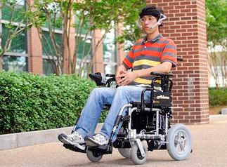

Finally
A brief introduction to input/output
Notes:
Tongue input, http://inputandoutputdevices.wikispaces.com/file/view/tongue-device.jpg/113010739/323x238/tongue-device.jpg
Oculus rift http://static3.businessinsider.com/image/51d1949aecad04ad3e000000/heres-what-happened-when-we-strapped-a-bunch-of-people-into-the-oculus-rift-virtual-reality-headset.jpg

Slide 6
I/O is complicated!
I previously taught a semester-long course on input and output (happy to share the slides)
For this class, understand what is convention (and identify opportunities to improve it)

Slide 7
Input and output on mobile devices
Input
Touch screen
Touch gestures
Physical buttons
Movement
Voice commands
Contextual info
e.g. location
Output
Screen
Audio
Vibration
Notification lights
Connected devices (eg smartwatch)

Slide 8
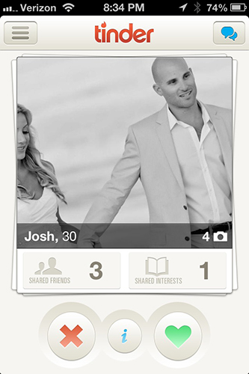
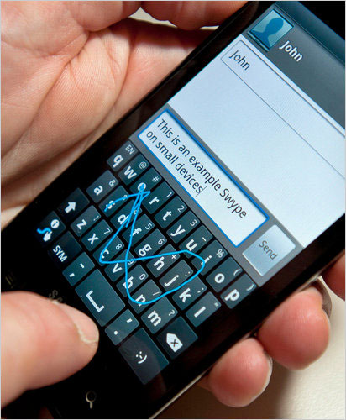
“Traditional” types of input
Text entry
Pointing / selection
Notes:
Swype, http://9to5google.files.wordpress.com/2011/10/swype-100621.jpg
Tinder, http://s3.r29static.com/bin/entry/69a/x/1075078/image.jpg

Slide 9
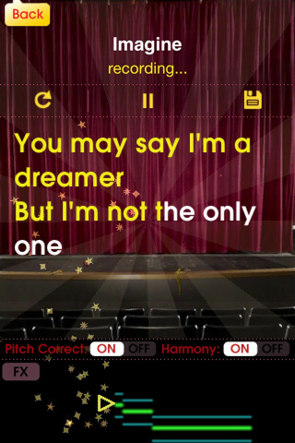
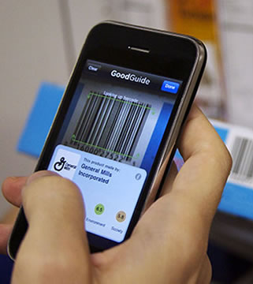
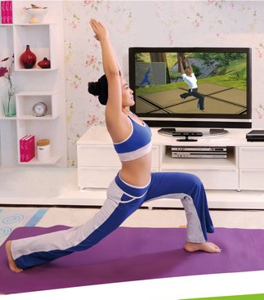
Other forms of input
Voice
Images / video
Movement
Notes:
Glee Karaoke, http://inventorspot.com/files/images/Glee_-_1.img_assist_custom.jpg
Barcode scanner, http://contentinjection.com/wp-content/uploads/2014/03/reliable-barcode-scanner-app.jpg
Yoga Klinect app, http://gadgetizor.com/wp-content/uploads/2012/04/ct51.jpg

Slide 10

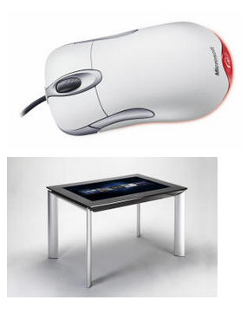
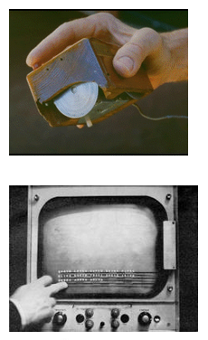
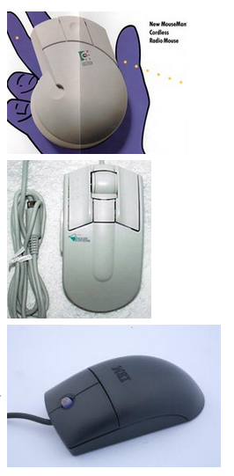
Notes:
http://www.billbuxton.com/inputTimeline.html Thanks, Jennings!

Slide 11
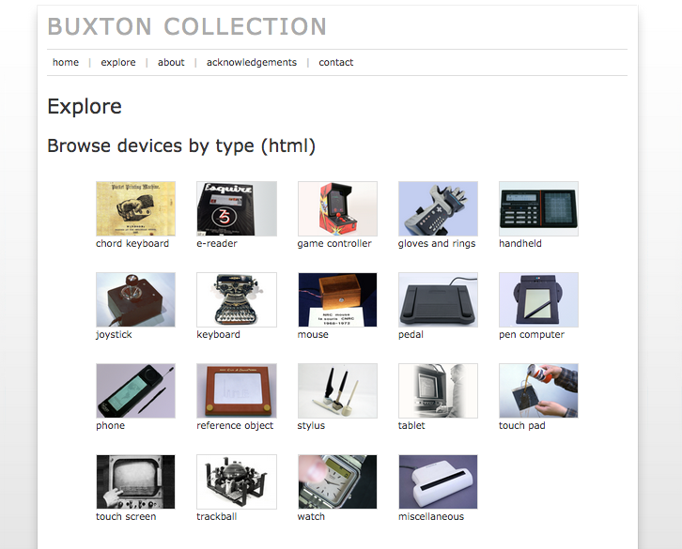
Notes:
http://research.microsoft.com/en-us/um/people/bibuxton/buxtoncollection/browse.aspx
Thanks to Jennings

Slide 12
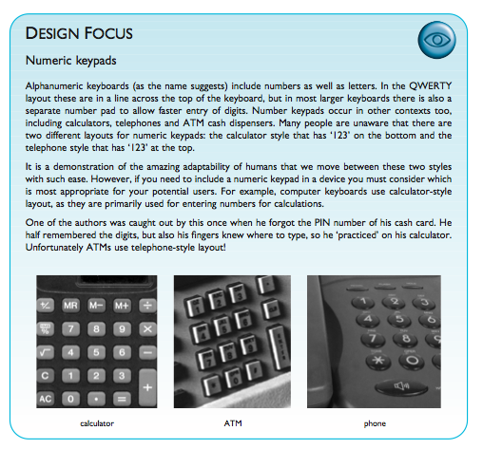
Change is fast

Slide 13
6 Thoughts on Input/Output
Consider environment
Remember human limitations
“Intuitive” usually isn’t
Reduce input complexity
Leverage past behavior
Leverage contextual information

Slide 14
1. Consider the environment
What do we know about the possible environments of use?
Notes:
Weather? Movement? Ambient noise?

Slide 15
1b. Use while moving
Negatively affects
Reading ability
Reading speed
Pointing ability
Users may be “situationally impaired”
Sears, A., & Young, M. (2002, January). Physical disabilities and computing technologies: an analysis of impairments. In The human-computer interaction handbook (pp. 482-503). L. Erlbaum Associates Inc..

Slide 16
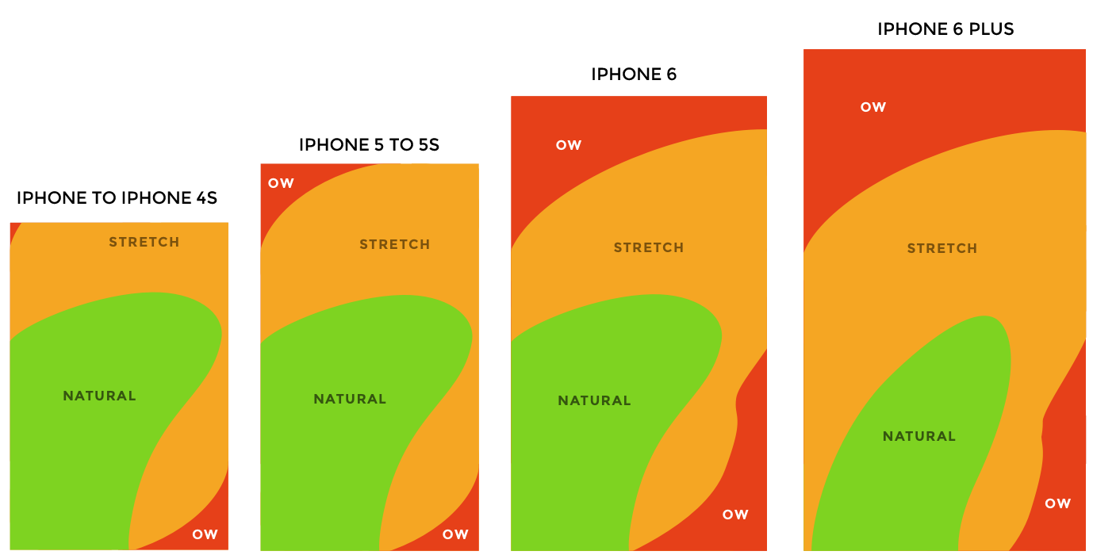
2. Remember human limitations
Reach, size, memory, vision, parallel processing…
(remember back to The Human)
Notes:
http://img.qz.com/2014/09/thumb-zones-lineup.png

Slide 17
2b. Fitts’ Law
Law of human performance for describing acquiring a target
MT = a + b log₂(A / W + 1)

Slide 18
Fitts’ law
MT = a + b log₂(A / W + 1)

Slide 19
Fitts’ law
MT = a + b log₂(A / W + 1)
MT = movement time

Slide 20
Fitts’ law
MT = a + b log₂(A / W + 1)
MT = movement time
ID = index of difficulty

Slide 21
Fitts’ law
MT = a + b log₂(A / W + 1)
MT = movement time
ID = index of difficulty
A = amplitude (distance)

Slide 22
Fitts’ law
MT = a + b log₂(A / W + 1)
MT = movement time
ID = index of difficulty
A = amplitude (distance)
W = target width

Slide 23
Fitts’ law
MT = a + b log₂(A / W + 1)
MT = movement time
ID = index of difficulty
A = amplitude (distance)
W = target width
a and b are constants (empirically determined)

Slide 24
Fitts’ law
Follow when we want to acquire targets (touch, with mouse, etc.)
MT is lowest when targets are:
Really big
Close together

Slide 25


3. Intuitive usually isn’t
A lot of what we think of as “intuitive” or natural is learned
Gestures
Sounds
UI conventions
Notes:
gesture, http://upload.wikimedia.org/wikipedia/commons/c/cc/Pinch_zoom.png
Hamburger menu, http://www.attacat.co.uk/wp-content/uploads/burger1.png

Slide 26

http://www.youtube.com/watch?v=hShY6xZWVGE

Slide 27
Input is difficult
Especially while mobile
So…

Slide 28
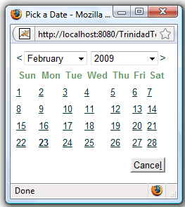
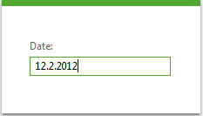
4. Reduce input complexity
Notes:
http://www.telerik.com/sfimages/default-sohttp://www.jsftoolbox.com/images/trinidad/trinidad-tr-inputDate.gifurce/productsimages/asp.net-ajax/productitemfeatures/input_raddateinput_screenshot-png.png?sfvrsn=0
Reduce number of clicks AND reduce error
Can we simplify this further? What if we are making an airline reservation app?

Slide 29
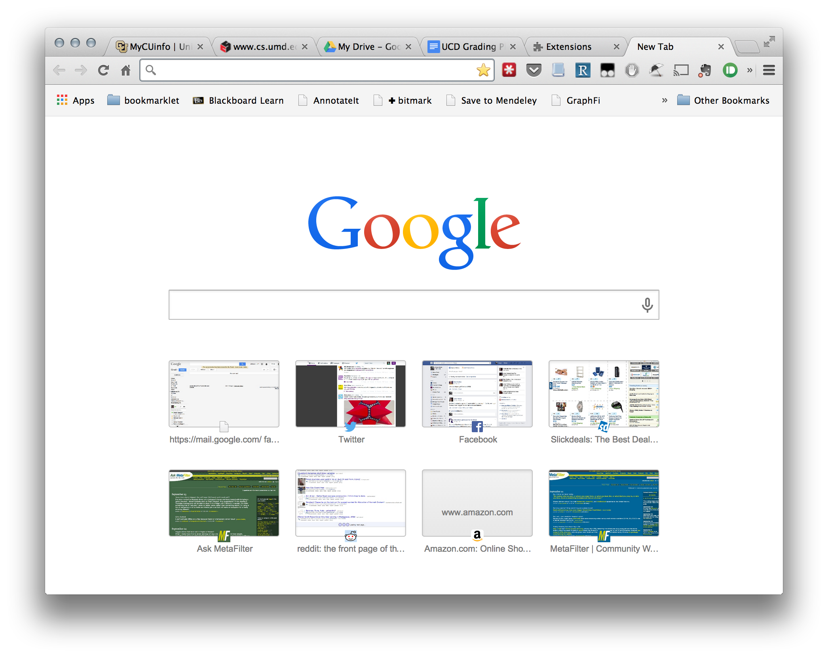
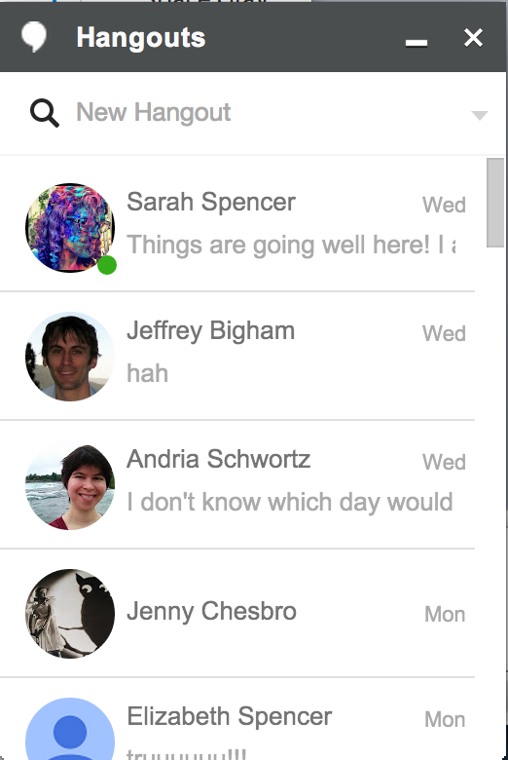
5. Leverage past behavior
Best predictor of future behavior
Notes:
Google

Slide 30
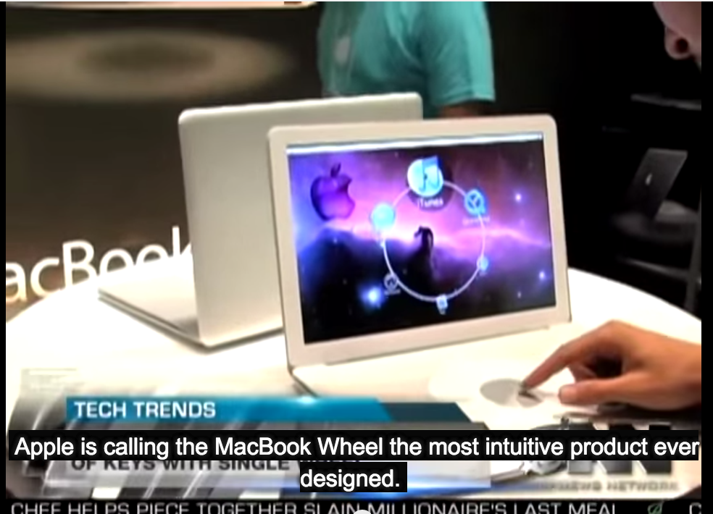
http://www.youtube.com/watch?v=9BnLbv6QYcA

Slide 31
6. Leverage context
What do our devices know about our situation? How can this help?

Slide 32
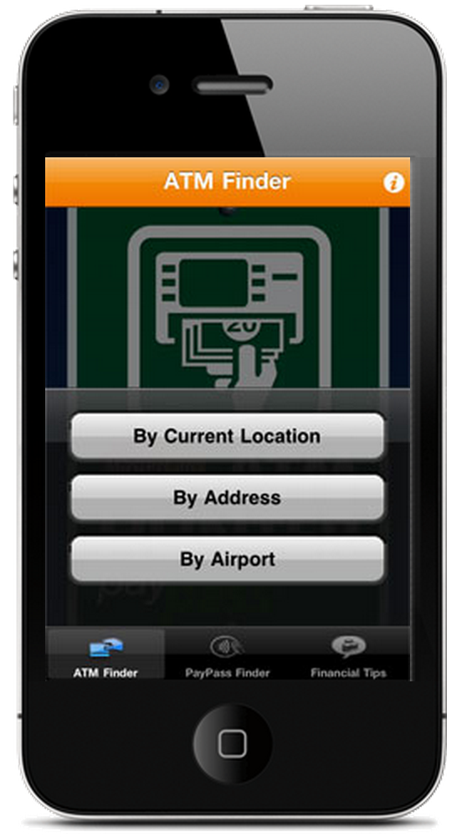
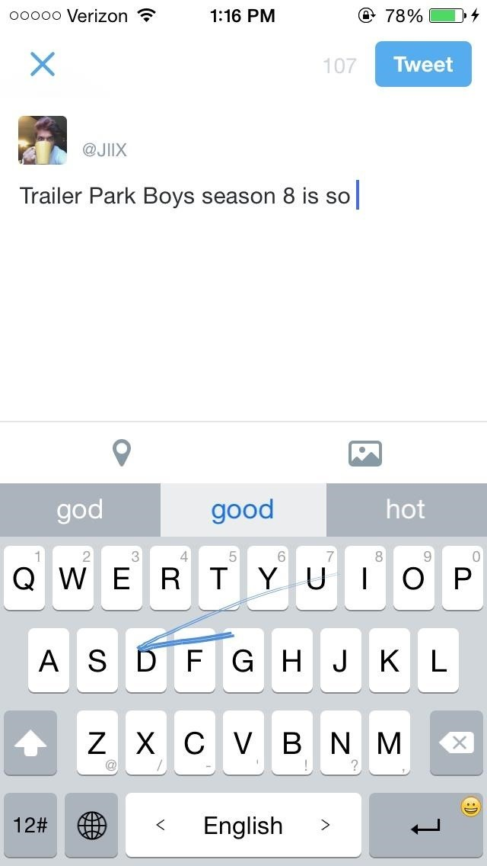
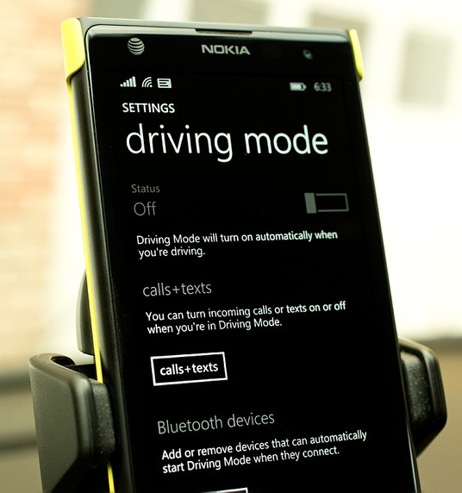
Notes:
MasterCard ATM hunter http://www.mastercard.us/small-business/mobile/atm-hunter.html
http://www.wpcentral.com/sites/wpcentral.com/files/styles/large_wm_blw/public/field/image/2014/04/Drive_Mode.jpg?itok=EEfziraX
Iphone keyboard http://img.wonderhowto.com/img/87/34/63546643204426/0/6-best-third-party-keyboards-available-right-now-for-ios-8.w654.jpg

Slide 33
Sketching

Slide 34
Sketching
Why sketch
How to sketch
Storyboarding

Slide 35
What is sketching?
Representing early ideas outside of your brain
Many forms: block diagrams, drawings, storyboards, text
Early ideas at a level of detail that is easy to work with

Slide 36
Why sketch
Capture ideas before you forget them
Feed the creative part of your brain
Try out ideas quickly (and discard bad ones)
Prevent yourself from getting distracted by SQUIRREL details

Slide 37
Other uses for sketches
Sketching for communication
Sketching for collaboration
Sketching as record
Notes:
Low barrier to entry
Easier to give feedback

Slide 38
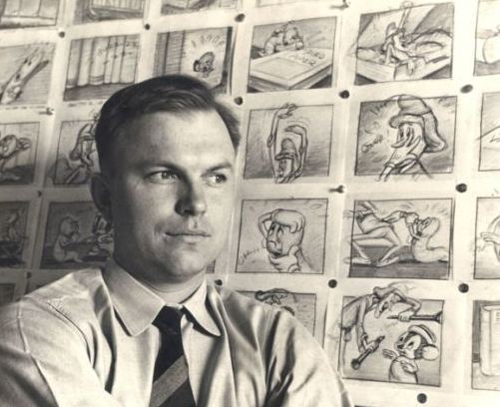
“The whole essence of good drawing – and of good thinking, perhaps – is to work a subject down to the simplest form possible and still have it believable for what it is meant to be.”
–Chuck Jones

Slide 39
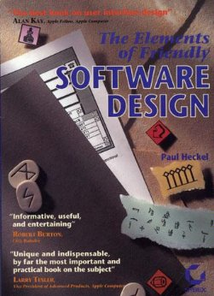
“If Ernest Hemingway, James Mitchener, Neil Simon, Frank Lloyd Wright, and Pablo Picasso could not get it right the first time, what makes you think that you will?“
— Paul Heckel

Slide 40
Myths about sketching
I can’t sketch!
I need to be an artist to sketch
I’ll save time by going straight to my dev environment

Slide 42
Sketching tools
Skitch: http://evernote.com/skitch/
Balsamiq: http://balsamiq.com/
Many apps, e.g. Paper http://www.fiftythree.com/paper

Slide 43
Sketching tools
Skitch: http://evernote.com/skitch/
Balsamiq: http://balsamiq.com/
Many apps, e.g. Paper http://www.fiftythree.com/paper
But really, start with paper
(get fancy notebooks/pens if it helps)

Slide 44
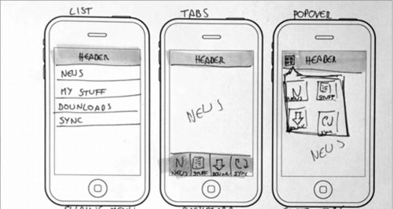
Divergent sketching
Notes:
No one should ever say, at this stage, whoa, that idea is TOO different

Slide 45
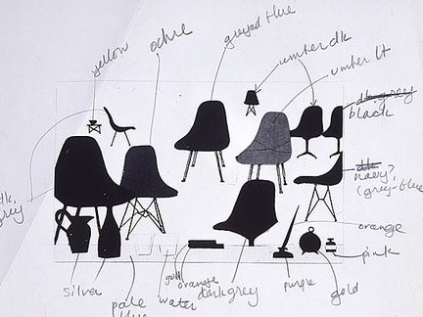
Convergent sketching
Charles Eames (dwr.com)

Slide 46

Sketching physical objects
Jeff Hawkins’ (Palm) block of wood
Notes:
Physical prototyping
http://idintern.wordpress.com/2011/02/03/business-realities/s

Slide 47
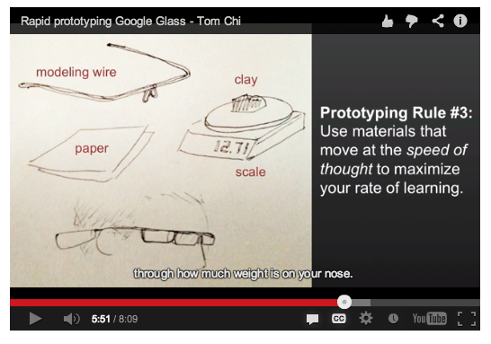
Google Glass in chopsticks
http://glass-apps.org/google-glass-prototype

Slide 48
Tips for sketching
Make LOTS of sketches
Hang them on the wall
Sketch neatly, so you can go back to your sketches later (and share them)
OK to take shortcuts (trace images, reuse elements across sketches)

Slide 49
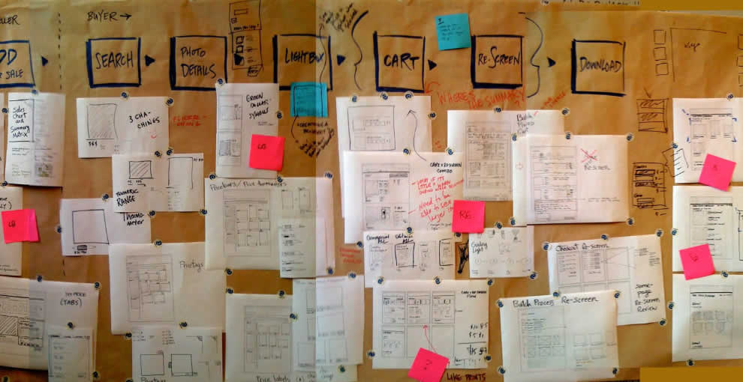
Notes:
http://wireframes.linowski.ca/2009/05/sketchboarding/

Slide 50

Star people
Notes:
http://brylie.gnumedia.org/storyboarding/
Why are star people better than stick people?

Slide 51
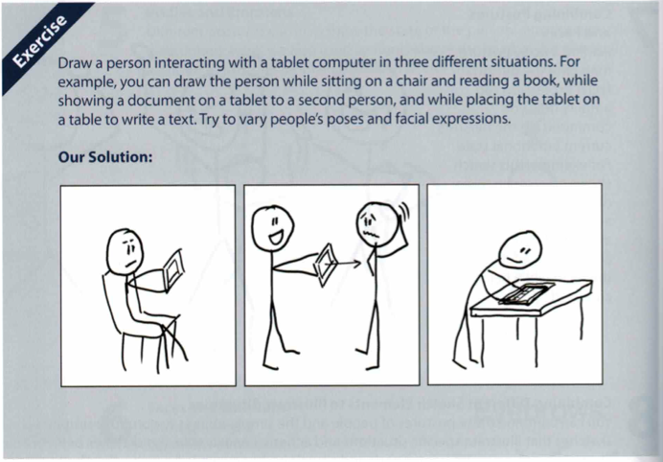
Activity

Slide 52
Next time
User research and requirements gathering

